Slide 1
AARON GOLD HCI 440 INTEGRATED FLYING EXPERIENCE

Slide 2
INTEGRATED APP FOR FLYING
This integrated experience app will be for people traveling by plane, which includes buying tickets, spending time at the airport, and flying on the plane. The app will help users have a better experience, with better knowledge throughout the traveling process.
This is a good candidate for an integrated experience because it is something that can be widely used and can make flying a more enjoyable experience. Users will benefit from this app by being better informed with information before, during and after flights

Slide 3
AFFORDANCES
Buying Tickets
Users can select flights that they are interested in purchasing and the app can monitor the price for changes, and give notifications until they purchase the ticket. The app also provides general price predictions and recommends when to buy tickets for a particular day or flight.
Informs users of baggage and other fees and can adjust airline prices to include these fees.
Keeps track of flight receipts and flight purchase history.
Shows all the amenities and features about the flight that you are taking, including whether the airplane offers in-seat charging or personal in seat screens.
Spending time at the airport
App will provide information about the airport and terminal you are at (uses GPS to recognize where you are).
Shows all the airlines at that terminal as well as the locations of shops, food, lounges, and restrooms. Also gives a map of the airport and terminal.

Slide 4
AFFORDANCES CONT.
Flying on the plane
Users can see a flight map/ flight tracker throughout the flight, which would work with internet and GPS. If GPS is not available then the app can show your approximate location based on departure time, ETA, and historical flight paths.
Bluetooth messaging – Allows messaging on the plane without internet.
Users can also record what they did during the flight such as work, sleep, watch a movie etc.
After flights
Provides info about how long the flight and travel process took. Keeps record of all the users trips and flights with information on destinations, origins, dates and prices (similar to Uber’s display of trip information).
This data will be useful for users who want to look back on past trips for nostalgia and reference.
Community
Users of the same app can connect or friend each other and post on a feed. They can also chat with each other - which can be done with internet, or if not available, Bluetooth.
This data will be useful for users who want to look back on past trips for nostalgia and reference.

Slide 5
USERS
Business Traveler
Frequent flyer usually buys airline ticket with points or company pays for flight.
Often goes to new airports and is not always familiar with the airport and terminals.
Is always on a tight schedule.
Parents travelling with children/family
Enjoys travelling to new places and spending time with family.
Want to ensure family's well being and always be in touch with family members.
Love taking pictures and remembering their experiences.

Slide 6
SCENARIOS
Business Traveler
The business person looks at the flight travel history data from his phone to see similar trips that he has done in the past so he can better plan this trip and be confident about his schedule. When he is at the airport for his return flight, he wants a place where he can relax, do some work and make calls. He uses the app to help him locate all the airport lounges he has access to. During the flight, he uses the flight tracker feature to know where he is, which puts him at ease. At the end of the flight, he writes down the work that he did and how he rested for part of the flight.

Slide 7
SCENARIOS CONT.
Parents travelling with their children
Mother wants to buy tickets for family to go to Miami. She isn’t ready to buy the ticket yet, so she uses the app to select the ticket she is interested in buying and gets notifications about price changes. The family benefits from recommendations of when to buy tickets, which the app offers. In the airport, they can use the app to find all the shops, food and restrooms in the terminal. On the plane, the father is not seated with the mother and children, but they can use the Bluetooth messaging feature to communicate. After the flight is over, the travel log is recorded, which is added their trip history.

Slide 8
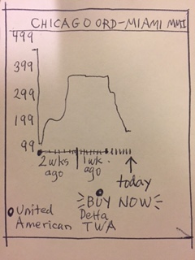
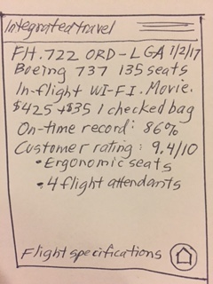
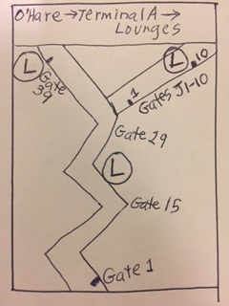
SKETCHES
Flight booking recommendations/ tracking
Airplane info/features, prices adjusted for bags
Terminal map and info(lounges)

Slide 9
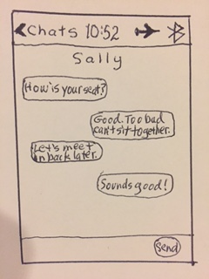
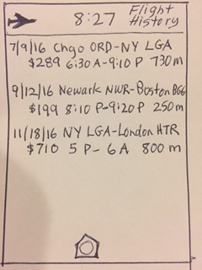
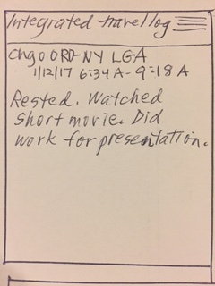
SKETCHES CONT.
Bluetooth in-flight messaging
Flight log history
Individual flight log/ diary entry

Slide 10
POTENTIAL PROBLEMS
Some information may not be 100% accurate, such as location of shops. Fare predictions may also be inaccurate.
To remedy this, it is necessary to monitor, verify, update and learn from errors. Users can submit feedback.
Bluetooth may not always be reliable, especially across greater distances.
More research should be done to ensure functionality.

Slide 11
INSIGHTS
Each step of the assignment help me to better understand my idea.
My idea was not much at first but as I worked on the assignment with the steps the idea was more clear, and I was able to come up with additional features and expand on my thoughts.
The sketching was something that was the icing on the cake for the idea. If I wasn’t sure about something the sketch made me more sure about it.

Slide 12
OTHER IDEAS
Going on a cruise
Going to a basketball or sports game
Going to the doctor
Going for a run, running in a marathon
Going to an Art museum

